Slide 1



Second Review
An Expected Gradient Length Driven Active Learning Framework for Multi-Class Sentiment Analysis Using Transformer Models
Batch N0:259
Presented By:
221FA04625 M.Shanmukha Priya
221FA04700 K.Swathi
Guide details:
Mrs . S. Anitha
Asst.Prof
Dept of CSE

Slide 2


Agenda Overview
01
Introduction
02
Objective
03
Dataset Description
04
Literature Survey
05
Methodology
06
Identification of Tools / Equipment / Training Needs

Slide 3

Introduction
Sentiment analysis is a key task in Natural Language Processing (NLP) that involves determining the emotional tone expressed in text.
It is widely used in fields such as social media monitoring, customer feedback analysis, and market research to extract opinions and attitudes from written language.
Sentiment analysis helps identify whether the sentiment in a piece of text is positive, negative, or neutral.

Slide 4
Objective
The objective of this project is to improve sentiment classification accuracy by using transformer-based models while reducing manual labeling effort through an uncertainty-aware active learning approach.
GitHub Repository
https://github.com/Shannu1695/Final-Year-Project

Slide 5
Datasets Statistics
Component | Samples
Total Dataset | 50,000
Training Set | 40,000
Test Set | 10,000
Initial Labeled | 10,000
Initial Unlabeled | 30,000
Samples Added per Cycle | 200
Maximum Iterations | 150
Component | Samples
Total Dataset | 18,944
Training Set | 15,155
Test Set | 3,789
Initial Labeled | 1,516
Initial Unlabeled | 13,639
Samples Added per Cycle | 100
Maximum Iterations | 136
Table.6. IMDB
Table.7.Twitter U.S.Airline

Slide 6
First Review Progress
Problem identification and formulation of sentiment analysis as a binary and multi-class text classification problem (IMDB – Positive/Negative, Twitter – Positive/Neutral/Negative).
Literature survey on transformer-based deep learning architectures (BERT, RoBERTa, DistilBERT, ALBERT, DeBERTa) and Active Learning techniques (Expected Gradient Length - EGL) used for efficient sentiment classification.
Dataset selection (IMDB Movie Review Dataset and Augmented Twitter Sentiment Dataset – public benchmark datasets) and understanding of text characteristics, class distribution, and real-world relevance in opinion mining and social media analysis.
Data preprocessing steps:
Text cleaning (removal of URLs, special characters, emojis)
Lowercasing and normalization
Tokenization using transformer tokenizers
Handling class imbalance (if required)
Dataset splitting (Train, Validation, Test – 80/10/10)
Initial model selection and feasibility analysis: Selection of pre-trained transformer models for fine-tuning Comparison of lightweight (DistilBERT, ALBERT) vs heavyweight models (BERT, RoBERTa, DeBERTa)
Preparation of First Review PPT including:
Abstract
Objectives
Proposed Methodology

Slide 7
Second Review Progress
• Contextual feature extraction using Transformer-based language models to capture semantic meaning and long-range dependencies in text.
• Implementation of multiple Transformer models: BERT RoBERTa DistilBERT ALBERT DeBERTa
• Development of Active Learning Framework: Expected Gradient Length (EGL) based sampling Uncertainty-based sample selection Iterative retraining with informative samples
• Model training and performance comparison across binary (IMDB) and multi-class (Twitter) sentiment datasets.
• Hyperparameter tuning: Learning rate optimization Batch size tuning Dropout regularization Number of training epochs selection Maximum sequence length adjustment

Slide 8
Literature Survey
S.No | Paper Title | Year, Publisher | Highlight | Methods Used | Dataset | Accuracy | Limitations
1 | Active Learning Based on Transfer Learning Techniques for Text Classification | 2023, IEEE Access | Combines active learning with transfer learning to reduce labeled data | Uncertainty Sampling, Random Forest | IMDB, Spam, Amazon Reviews | 85% | Requires similar source and target datasets
2 | Active Learning Empowered Sentiment Analysis for Smartphone Customer Reviews | 2024, IEEE Transactions on Consumer Electronics | Uses active learning to improve classification of Flipkart smartphone reviews | TF-IDF + ML classifiers | Flipkart Reviews | 89% | Dataset imbalance
3 | Sentiment Analysis Framework using Deep Active Learning for Smartphone Aspect-Based Rating Prediction | 2023, Foundations of Computing and Decision Sciences | Uses deep active learning with LSTM for smartphone aspect rating prediction | LSTM + Active Sampling | Amazon & Twitter Reviews | 82.8% | High computational cost

Slide 9
Performance Evaluation of the Proposed Model
The proposed Uncertainty-Aware Active Learning Framework using Transformer Models was evaluated using multiple quantitative performance metrics to ensure high classification accuracy and robustness. The datasets consisted of:
Binary classification (IMDB): Positive, Negative
Multi-class classification (Twitter): Positive, Neutral, Negative
The evaluation metrics included:
Accuracy
Precision
Recall
F1-Score
Confusion Matrix
ROC-AUC
Among all models, DeBERTa with EGL-based Active Learning achieved an overall accuracy of approximately 94% on the IMDB dataset, outperforming other transformer models such as BERT, RoBERTa, DistilBERT, and ALBERT.
The integration of Expected Gradient Length (EGL) reduced labeling effort and improved model generalization by selecting the most informative training samples. This resulted in better contextual understanding, improved class separation, and balanced performance across sentiment classes.

Slide 10
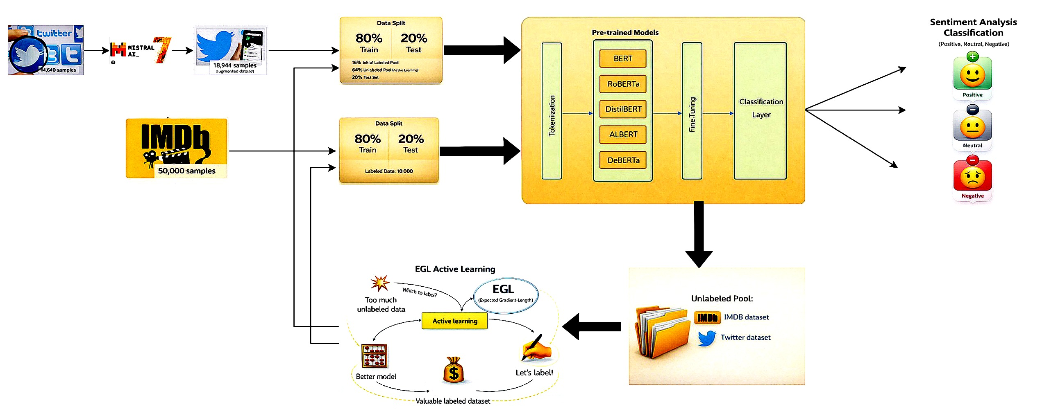
Proposed System Architecture

Slide 11
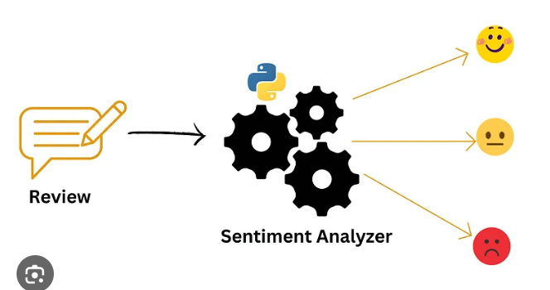
Methodology
Dataset Collection: Use publicly available sentiment datasets such as IMDB movie reviews or Twitter text datasets.
Data Preprocessing: Clean the text by removing noise, stop words, URLs, and special characters, followed by tokenization suitable for transformer models.
Transformer Model Training: Fine-tune transformer-based models (BERT, DistilBERT, RoBERTa) on a small labeled dataset to capture contextual sentiment information.

Slide 12
Dataset Collection: Use publicly available sentiment datasets such as IMDB movie reviews or Twitter text datasets.
Data Preprocessing: Clean the text by removing noise, stop words, URLs, and special characters, followed by tokenization suitable for transformer models.
Baseline Model Training:
T
Gradient Estimation: Identify samples with low confidence predictions from the unlabeled data pool using model uncertainty measures.
Active Learning Loop: Select the most uncertain samples, label them, and add them to the training set for iterative retraining.
Model Evaluation: Evaluate all models using accuracy, precision, recall, and F1-score to analyze performance improvement.
Final Model Selection: Select the best-performing model as the final sentiment analysis system.

Slide 13
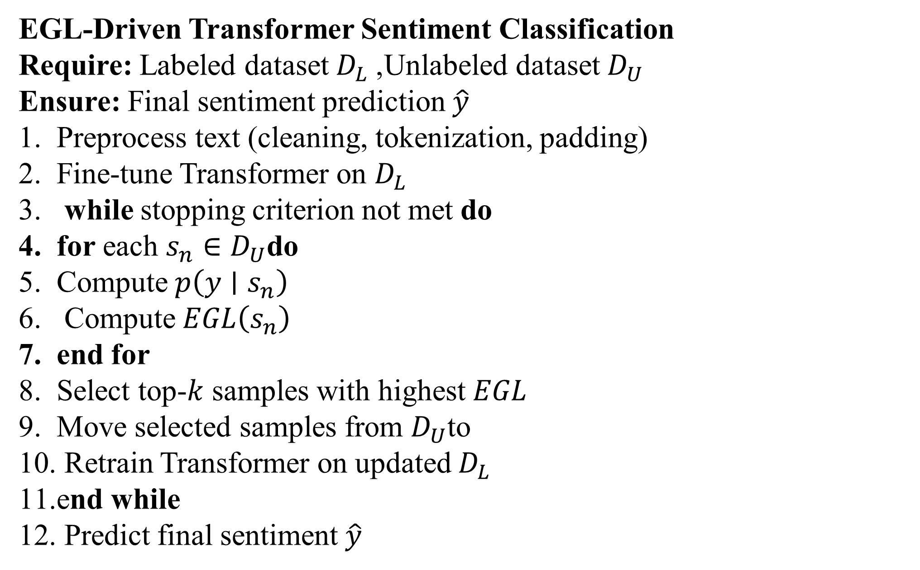
Algorithm
EGL-Driven Transformer Sentiment Classification
Require: Labeled dataset $D_{L}$, Unlabeled dataset $D_{U}$ Ensure: Final sentiment prediction $\hat{y}$
Preprocess text (cleaning, tokenization, padding)
Fine-tune Transformer on $D_{L}$
while stopping criterion not met do
for each $s_{n}∈D_{U}$do
Compute $p\left(y∣s_{n}\right)$
Compute $EGL\left(s_{n}\right)$
end for
Select top-$k$ samples with highest $EGL$
Move selected samples from $D_{U}$to
Retrain Transformer on updated $D_{L}$
end while
Predict final sentiment $\hat{y}$

Slide 14

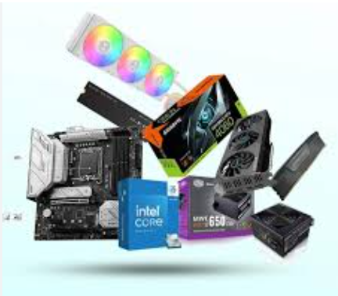
Tools & Learning Status
Content:
Programming: Python
Libraries: NumPy, Pandas, Scikit-learn, PyTorch, Transformers
Platform: Google Colab (GPU Enabled)
Visualization: Matplotlib, Seaborn
Dataset Handling: IMDB + Twitter dataset
Learning Status:
Completed basics of NLP and Transformers
Learned BERT, RoBERTa, DistilBERT models
Understood Active Learning (EGL method)

Slide 15
Results and Discussions
• Evaluated on IMDB (Binary) and Twitter (Multi-class) datasets.
• Performance metrics used: Accuracy, Precision, Recall, F1-Score, Confusion Matrix, ROC-AUC.
• DeBERTa + EGL achieved highest accuracy (~94%) on IMDB dataset.
• RoBERTa showed strong contextual understanding with high AUC.
• EGL-based Active Learning improved performance compared to random sampling by selecting informative samples.
• Better class separation and reduced misclassification in multi-class Twitter dataset.
• Lightweight models (DistilBERT) provided good accuracy with lower computational cost.
• Overall, the framework improved accuracy while reducing labeling effort.

Slide 16
RESULTS
Model | Sampling | Positive |  |  | Negative
 |  | F1-Score | Accuracy | AUC | F1-Score | Accuracy | AUC
BERT | Random | 0.88 | 0.85 | 0.94 | 0.86 | 0.84 | 0.93
 | EGL | 0.91 | 0.87 | 0.96 | 0.89 | 0.86 | 0.95
Distil BERT | Random | 0.84 | 0.82 | 0.91 | 0.83 | 0.8 | 0.9
 | EGL | 0.87 | 0.85 | 0.93 | 0.86 | 0.83 | 0.92
RoBERTa | Random | 0.9 | 0.88 | 0.97 | 0.89 | 0.86 | 0.96
 | EGL | 0.93 | 0.9 | 0.98 | 0.91 | 0.88 | 0.97
ALBERT | Random | 0.81 | 0.79 | 0.88 | 0.8 | 0.77 | 0.87
 | EGL | 0.84 | 0.82 | 0.9 | 0.83 | 0.8 | 0.89
DeBERTa | Random | 0.92 | 0.9 | 0.98 | 0.91 | 0.88 | 0.97
 | EGL | 0.95 | 0.93 | 0.99 | 0.94 | 0.91 | 0.98
Table.8. Class-wise Performance Comparison of Transformer Models with Random and EGL Sampling on IMDB Dataset

Slide 17
RESULTS
Model | Sampling | Positive |  |  | Neutral |  |  | Negative
 |  | F1-Score | Accuracy | AUC | F1-Score | Accuracy | AUC | F1-Score | Accuracy | AUC
BERT | Random | 0.82 | 0.80 | 0.91 | 0.75 | 0.73 | 0.88 | 0.81 | 0.79 | 0.9
 | EGL | 0.85 | 0.83 | 0.94 | 0.78 | 0.76 | 0.9 | 0.84 | 0.82 | 0.93
Distil BERT | Random | 0.8 | 0.78 | 0.9 | 0.74 | 0.72 | 0.87 | 0.79 | 0.77 | 0.89
 | EGL | 0.84 | 0.82 | 0.92 | 0.77 | 0.75 | 0.89 | 0.83 | 0.8 | 0.91
RoBERTa | Random | 0.86 | 0.84 | 0.96 | 0.8 | 0.78 | 0.92 | 0.85 | 0.83 | 0.95
 | EGL | 0.88 | 0.86 | 0.98 | 0.83 | 0.81 | 0.94 | 0.87 | 0.85 | 0.97
ALBERT | Random | 0.78 | 0.76 | 0.88 | 0.7 | 0.68 | 0.85 | 0.77 | 0.75 | 0.87
 | EGL | 0.81 | 0.79 | 0.89 | 0.73 | 0.71 | 0.87 | 0.8 | 0.78 | 0.88
DeBERTa | Random | 0.87 | 0.85 | 0.97 | 0.82 | 0.8 | 0.93 | 0.86 | 0.84 | 0.96
 | EGL | 0.90 | 0.88 | 0.99 | 0.85 | 0.83 | 0.95 | 0.89 | 0.87 | 0.98
Table.9. Class-wise Performance Comparison of Transformer Models with Random and EGL Sampling on IMDB Dataset

Slide 18
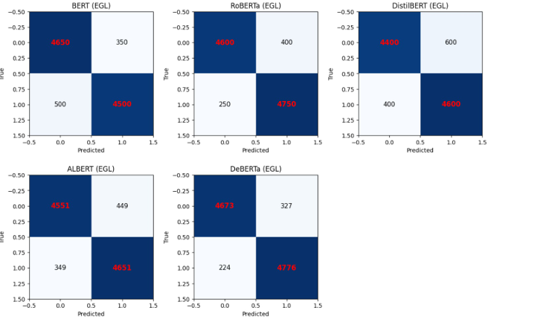
Confusion Matrix(IMDB)

Slide 19
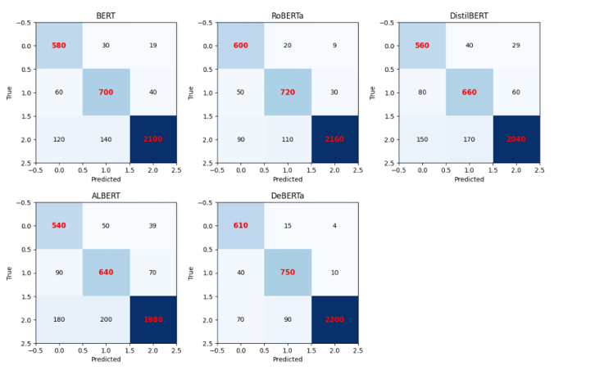
Confusion Matrix(Twitter)

Slide 20
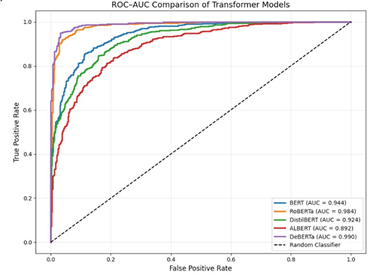
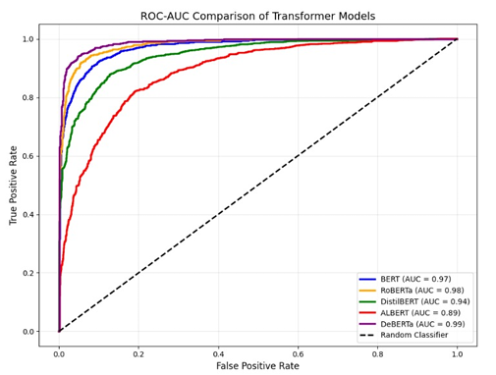
ROC -Curve
Fig. 10: ROC-AUC Comparison of Transformer Model of IMDB Data
Fig.11. ROC-AUC Comparison of Transformer Model of Twitter Data

Slide 21
Conclusion
Sentiment analysis helps find emotions in text, making it helpful for businesses, social media, and customer support. Using different methods makes it more accurate and better at understanding feelings. Advanced techniques make it more reliable and useful in real life. In the future, it can get better at understanding sarcasm, slang, and different languages.

Slide 22
THANK YOU…

